Slide 1
Week-4
COSC 32001 Computer Vision
Noopa Jagadeesh
Date: 1 Feb 2024

Slide 2

Critical Path

Slide 3

Evaluation

Slide 4
Recap
Template Matching
Image Segmentation Using K-means
Image Segmentation Using Color Spaces
Data Augmentation

Slide 5
Agenda
Simple Thresholding
Otsu Thresholding
Adaptive Thresholding

Slide 6
Image Segmentation with Thresholding

Slide 7
Image Segmentation with Thresholding
One of the most commonly used segmentation techniques is thresholding.
It is widely used in computer vision and is very useful to separate the object that we are interested in from the background.
Thresholding is the binarization of an image. In general, we seek to convert a grayscale image to a binary image, where the pixels are either 0 or 255.
Grayscale images are an array of shades. But in the binary images, the pixel values are either 0 or 255.
There are three different types of thresholding.
Simple Thresholding
Otsu Thresholding
Adaptive Thresholding
Simple Thresholding: This technique sets a threshold value and compares each pixel to that particular threshold value. If the pixel value is less than or equal to the assigned threshold, then the pixel value is set to zero or to the maximum value.
Simple thresholding can work well in very controlled lighting conditions where there is high contrast between the foreground (the object we are interested in, in the image) and background.
The hardest part about simple thresholding is, we need to manually supply the threshold values which may take a lot of trials.

Slide 8
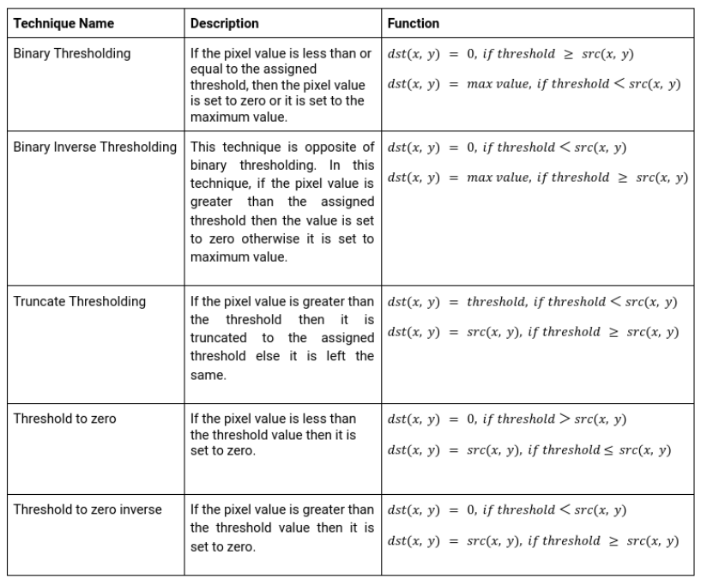
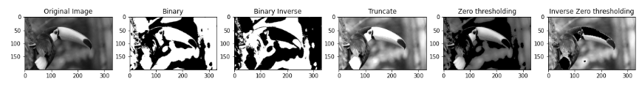
Image Segmentation with Thresholding
Simple Thresholding:
The below image is obtained after applying simple thresholding

Slide 9

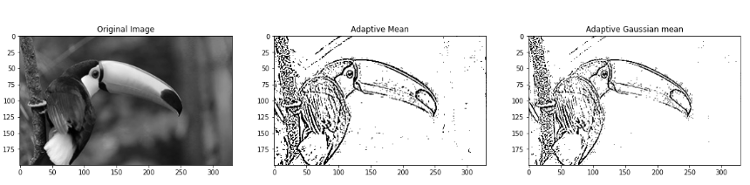
Image Segmentation with Thresholding
Otsu’s Thresholding
One of the ways to achieve an optimal threshold is Otsu’s method. In this method, we find the spread of foreground and background of the pictures for all possible values of threshold. The threshold with the least spread is taken as the optimal threshold.
Adaptive Thresholding
Both Simple thresholding and Otsu’s thresholding are global thresholding techniques using a single threshold value in image thresholding. But a single threshold value may not be sufficient because it may work well in a certain part of the image but may fail in another part. To resolve these limitations, adaptive thresholding can be used. Adaptive thresholding is a local thresholding technique. This technique considers each pixel and its neighborhood.

Slide 10
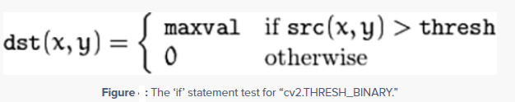
Simple Thresholding
Where we have to manually supply a threshold value, T.
A simple thresholding example would be selecting a threshold value T, and then setting all pixel intensities less than T to 0, and all pixel values greater than T to 255. In this way, we are able to create a binary representation of the image. This is called Binary Thresholding.
For example if we set the threshold value T=225 all pixels p in the image where p < T are set to 255, and all pixels p >= T are set to 0.
cv2.THRESH_BINARY: If pixel intensity is greater than the set threshold, value set to 255(white), else set to 0 (black).
All pixels value above 120 will be set to 255

Slide 11
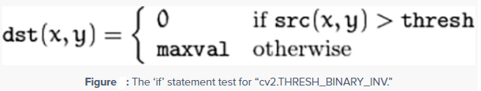
Simple Thresholding
Here, any pixel value that is greater than 120 is set to 0. Any value that is less than 120 is set to 255.
In most cases we are normally seeking our segmented objects to appear as white on a black background, hence using cv2.THRESH_BINARY_INV. But in the case that we want our objects to appear as black on a white background, be sure to supply the cv2.THRESH_BINARY flag.

Slide 12
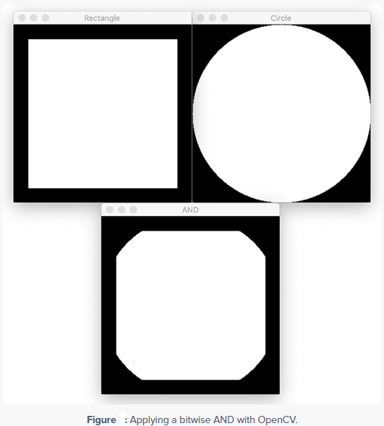
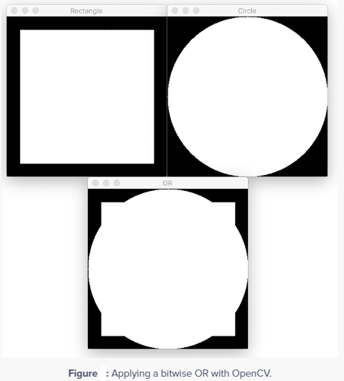
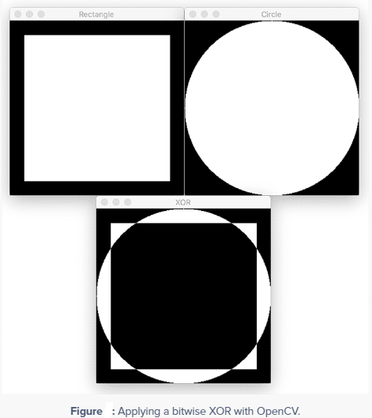


Arithmetic Operations on Images
AND: A bitwise AND is true if and only if both pixels are greater than zero.
OR: A bitwise OR is true if either of the two pixels is greater than zero.
XOR: A bitwise XOR is true if and only if one of the two pixels is greater than zero, but not both.
NOT: A bitwise NOT inverts the “on” and “off” pixels in an image.

Slide 13
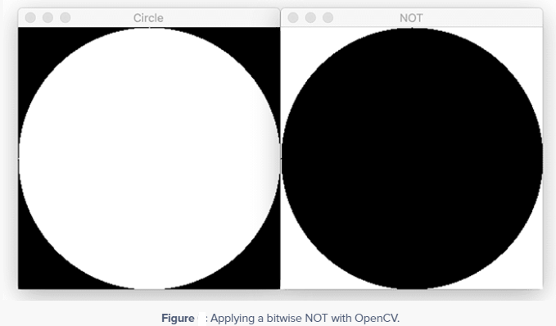
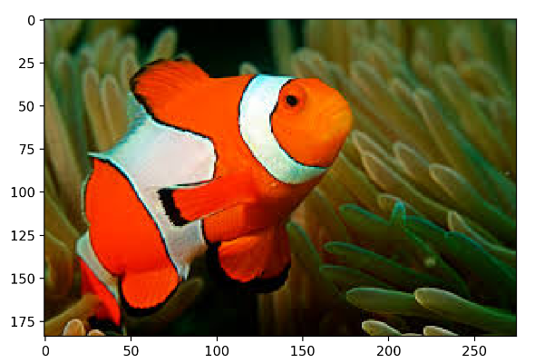
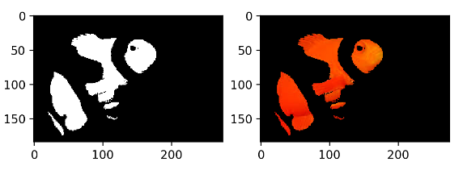

Arithmetic Operations on Images
AND: A bitwise AND is true if and only if both pixels are greater than zero.
OR: A bitwise OR is true if either of the two pixels is greater than zero.
XOR: A bitwise XOR is true if and only if one of the two pixels is greater than zero, but not both.
NOT: A bitwise NOT inverts the “on” and “off” pixels in an image.

Slide 14
Arithmetic Operations on Images
nemo mask result
How the Bitwise AND Operation Works:
The bitwise AND operation is performed on the binary representations of the pixel values of the images.
When an image is bitwise ANDed with itself without a mask, the result is simply the original image.
However, when a mask is applied, the output pixel value is calculated as follows:
If a pixel in the mask is 0, the corresponding pixel in the output image is set to 0 (black).
If a pixel in the mask is non-zero, the corresponding pixel in the output image retains its original value from the nemo image.
Purpose of Using a Mask:
A mask is used in image processing to focus on certain parts of an image while ignoring others.
Here the mask is used to isolate certain features or regions of the nemo image. For example, it could be used to highlight a specific color range or a region of interest.

Slide 15
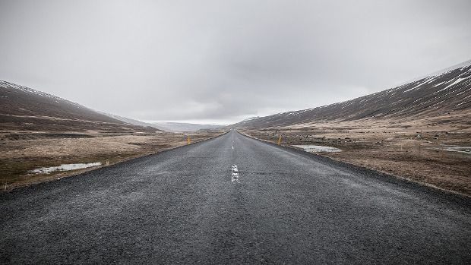
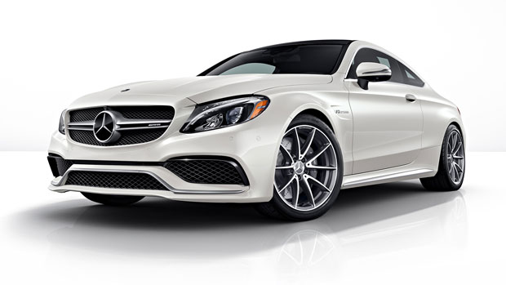
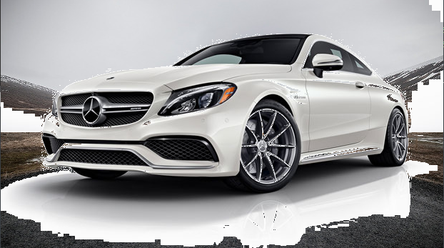
Add two Images/ Blending Images

Slide 16
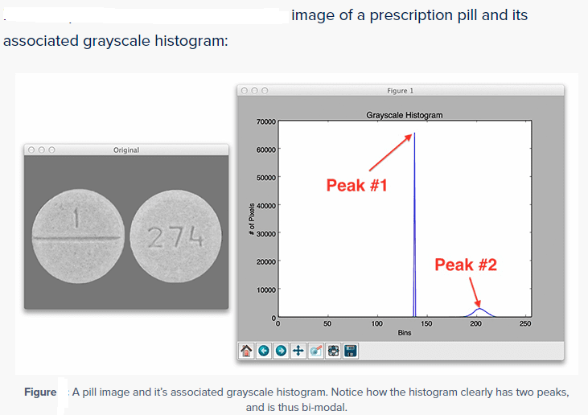
Otsu Thresholding
In simple thresholding we needed to manually supply a threshold value of T. For simple images in controlled lighting conditions, it might be feasible for us to hardcode this value.
But in real-world conditions where we do not have any priori knowledge of the lighting conditions, we can automatically compute an optimal value of T using Otsu’s method.
Otsu’s method assumes that our image contains two classes of pixels: the background and the foreground
Otsu’s method makes the assumption that the grayscale histogram of the pixel intensities of our image is bi-modal, which simply means that the histogram is two peaks.
Here the histogram clearly has two peaks — the first sharp peak corresponds to the uniform background color of the image, while the second peak corresponds to the pill region itself.
Based on the grayscale histogram, Otsu’s method then computes an optimal threshold value T such that the variance between the background and foreground peaks is minimal.

Slide 17

Otsu Thresholding
Otsu’s method has no prior knowledge of what pixels belong to the foreground and which pixels belong to the background — it’s simply trying to optimally separate the peaks of the histogram.
We start by passing in the (blurred) image that we want to threshold.
The second parameter (— this is supposed to be our threshold value T) is set to zero. This is because Otsu’s method is going to automatically compute the optimal value of T for us. We could technically specify any value we wanted for this argument.
The third argument is the output value of the threshold, provided the given pixel passes the threshold test. Pixels that meet or exceed the threshold will be set to this value.
The last argument is one we need to pay extra special attention to. Previously, we had supplied values of cv2.THRESH_BINARY or cv2.THRESH_BINARY_INV depending on what type of thresholding we wanted to perform. But now we are passing in a second flag that is logically OR’d with the previous method. Notice that this method is cv2.THRESH_OTSU, which obviously corresponds to Otsu’s thresholding method.
cv2.THRESH_OTSU instructs OpenCV to use Otsu's method to automatically determine the optimal threshold value. cv2.THRESH_BINARY is the basic binary thresholding type used ones we get the T.

Slide 18
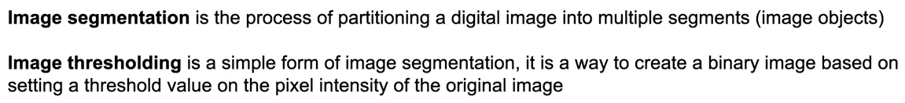
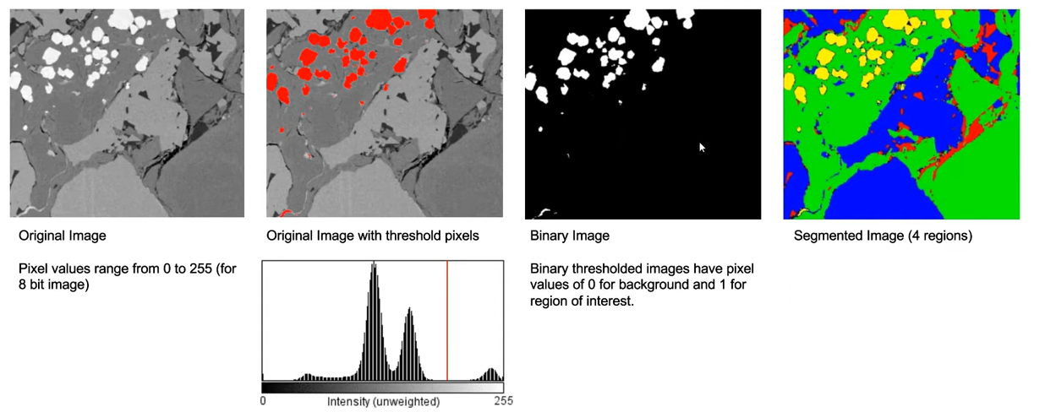
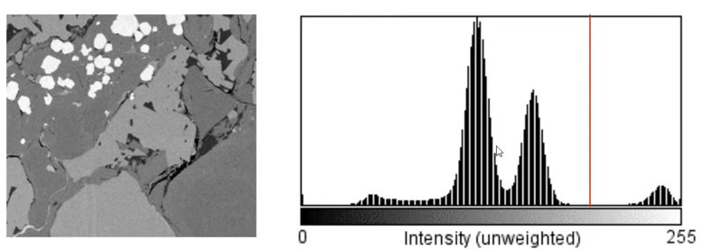
Image Segmentation

Slide 19
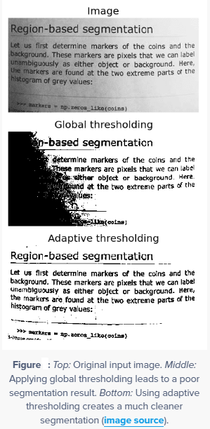
Adaptive thresholding
One of the downsides of using simple thresholding methods is that we need to manually supply our threshold value, T. Furthermore, finding a good value of T may require many manual experiments and parameter tunings, which is simply not practical in most situations.
To aid us in automatically determining the value of T, we leveraged Otsu’s method. And while Otsu’s method can save us a lot of time playing the “guess and checking” game, we are left with only a single value of T to threshold the entire image.
For simple images with controlled lighting conditions, this usually isn’t a problem. But for situations when the lighting is non-uniform across the image, having only a single value of T can seriously hurt our thresholding performance.

Slide 20
Adaptive thresholding
To overcome this problem, we can use adaptive thresholding, which considers small neighbors of pixels and then finds an optimal threshold value T for each neighbor. This method allows us to handle cases where there may be dramatic ranges of pixel intensities and the optimal value of T may change for different parts of the image.
In adaptive thresholding, sometimes called local thresholding, our goal is to statistically examine the pixel intensity values in the neighborhood of a given pixel, p.
The general assumption that underlies all adaptive and local thresholding methods is that smaller regions of an image are more likely to have approximately uniform illumination. This implies that local regions of an image will have similar lighting, as opposed to the image as a whole, which may have dramatically different lighting for each region.
However, choosing the size of the pixel neighborhood for local thresholding is absolutely crucial. The neighborhood must be large enough to cover sufficient background and foreground pixels, otherwise the value of T will be more or less irrelevant.
But if we make our neighborhood value too large, then we completely violate the assumption that local regions of an image will have approximately uniform illumination. Again, if we supply a very large neighborhood, then our results will look very similar to global thresholding using the simple thresholding or Otsu’s methods.

Slide 21
Adaptive thresholding
In practice, tuning the neighborhood size is (usually) not that hard of a problem. We’ll often find that there is a broad range of neighborhood sizes that provide you with adequate results — it’s not like finding an optimal value of T that could make or break your thresholding output.
To summarize, our goal in adaptive thresholding is to statistically examine local regions of our image and determine an optimal value of T for each region .
But which statistic do we use to compute the threshold value T for each region?
It is common practice to use either the arithmetic mean or the Gaussian mean of the pixel intensities in each region (other methods do exist, but the arithmetic mean and the Gaussian mean are by far the most popular).
In the arithmetic mean, each pixel in the neighborhood contributes equally to computing T. And in the Gaussian mean, pixel values farther away from the (x, y)-coordinate center of the region contribute less to the overall calculation of T.

Slide 22
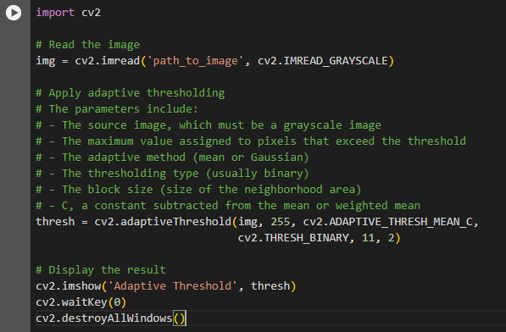
Adaptive thresholding
How Adaptive Thresholding Works:
Local Thresholds: Instead of a global threshold for the entire image, adaptive thresholding applies different thresholds for different regions of the image. This is particularly useful for images where lighting conditions vary across the image.
Dividing the Image: The image is divided into smaller blocks or regions, and the threshold for each block is computed as per a specific method.
Threshold Calculation: The threshold for a block can be determined in various ways, typically based on the mean or median of the pixel intensities in the block or a weighted sum of the neighborhood values minus a constant.
In this example, cv2.ADAPTIVE_THRESH_MEAN_C is the adaptive method where the threshold value is the mean of the neighborhood area minus the constant C. The block size (11 in this case) determines the size of the area to compute the threshold for. A block size of 11 means a 11x11 area is used to calculate the threshold. The constant C (2 in this case) is subtracted from the mean to fine-tune the thresholding.

Slide 23
Disclaimer
Due to nature of the course, various materials have compiled from different open source resources with some moderation. I sincerely acknowledge their hard work and contribution

Slide 24


